Slide 1
Data converter Project
Edgar Tonoyan
David Mamyan

Slide 2
Main Goal
Data Converter
This project’s main goal is to write a code, which will convert an available data from another library (json) and will print in the way, we implemented in a C code. One of the most popular examples is the gitlog.

Slide 3
Git Log
Git log - -pretty=format: ‘{%n “name”: “%cn” , %n “data”: “cd” , %n “body”: “%b” %n}
The git log command displays a record of the commits in a Git repository. By default, the git log command displays a commit hash, the commit message, and other commit metadata. You can filter the output of git log using various options.

Slide 4
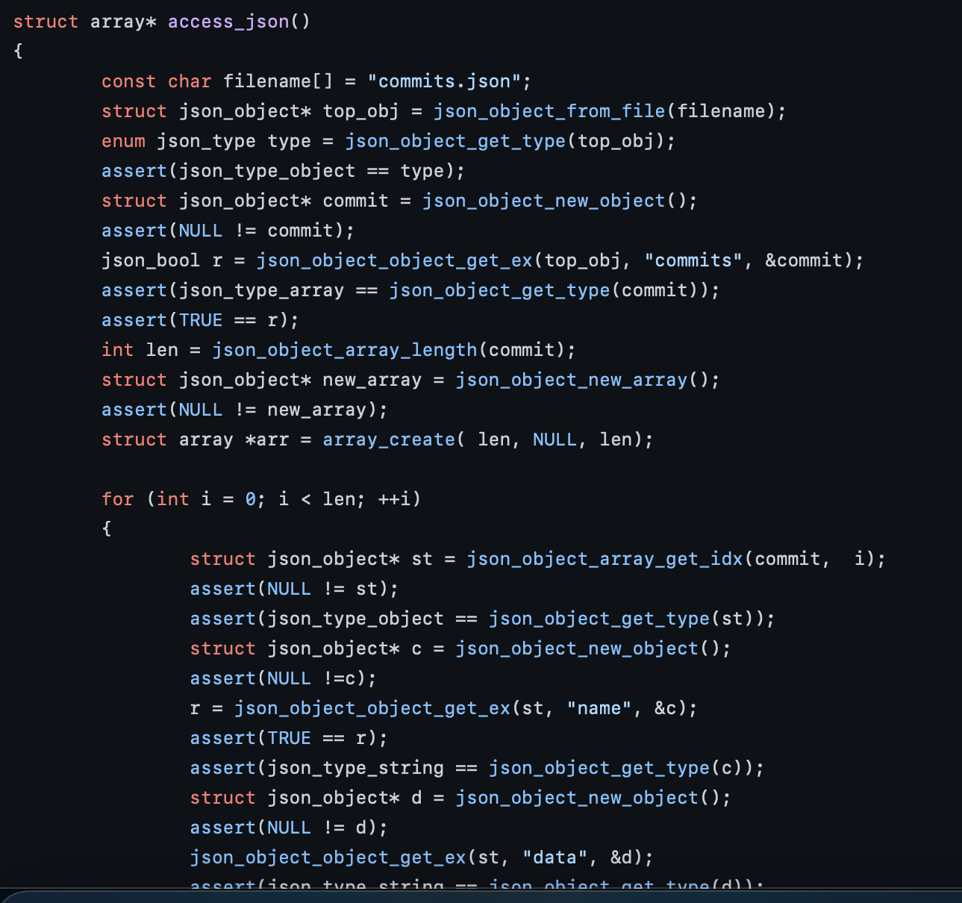
Json parsing in C
In order to execute this program, we need the details from our json file. So we wrote a json parsing code, which will allow us to use data from json file in our code.

Slide 5
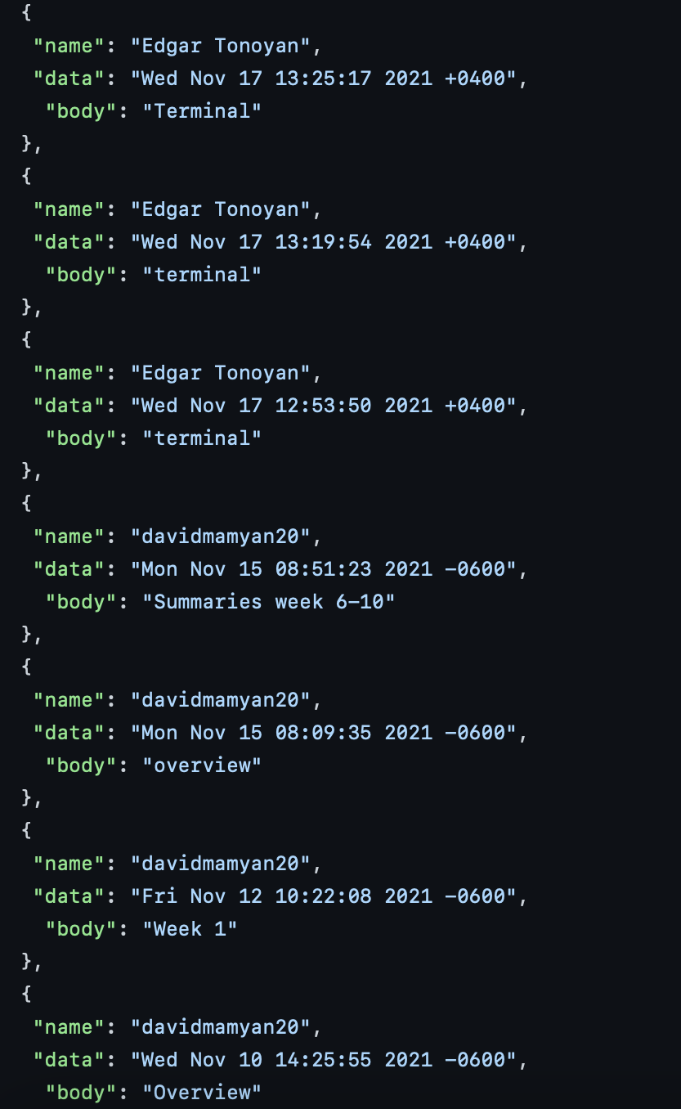
Json file
This is our json file, where the result our commits in the following repository is written.
When you run the code, the text from this program will be executed in C.

Slide 6
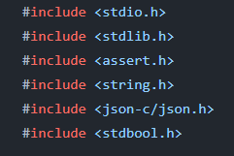
We are using the following libraries for executing this project.

Slide 7
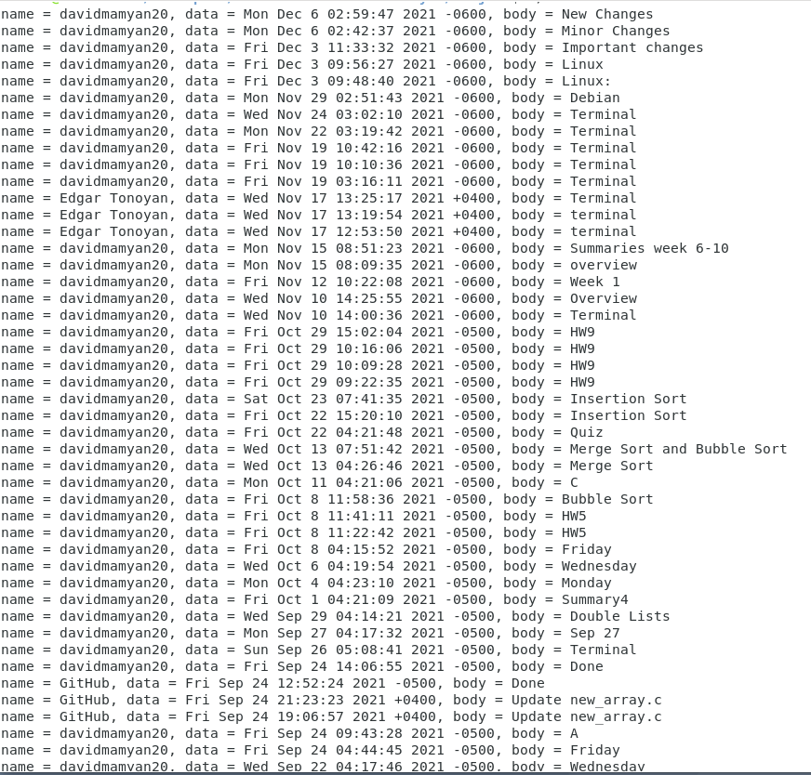
Result
Done via test

Slide 8
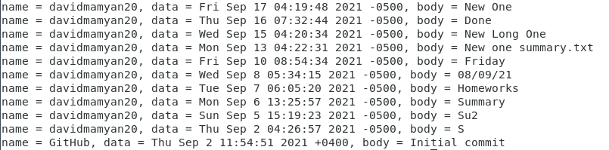
Result done via test part 2

Slide 9
THANK YOU
To compile we use the following commands
gcc gitlog.c -ljson-c
./a.out

